Slide 1
(Mostly) Unsupervised linear models in imaging…
Many of these slides were adapted from: Srinivasa Narasimhan, Todd Zickler, Steven Gortler, Kayvon Fatahalian

Slide 2
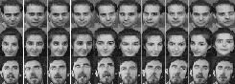
Recognition
PCA
Project images into low-D space
this represents the image DB
individuals (obj., people) in the database live in that volume
often, they “undulate” or “weave” through it, depending on pose, lighting, expressions, etc.
(1) match new images to classes
(2) represent object classes efficiently
Image coefficient space
We need to

Slide 3
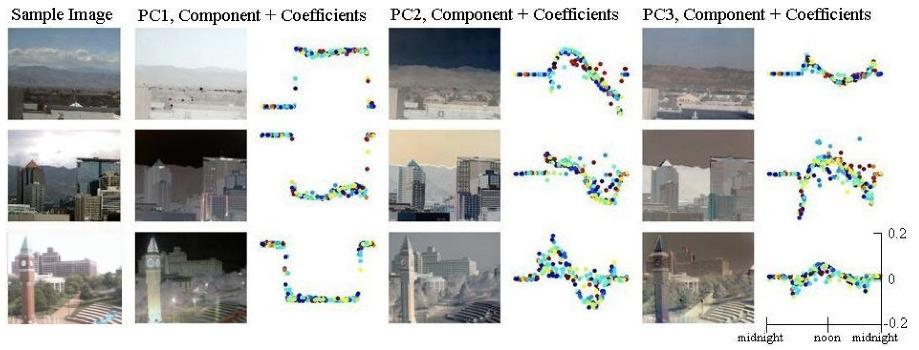

Slide 4
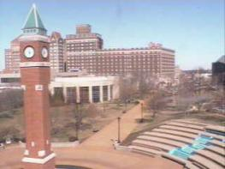
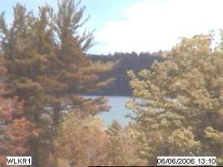
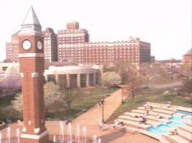
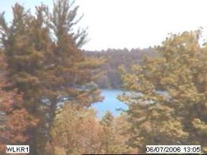
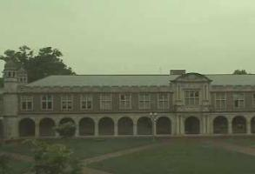
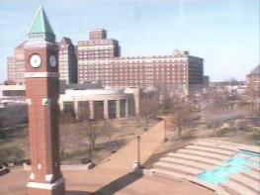
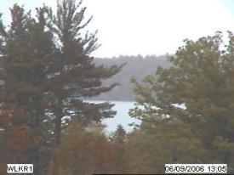
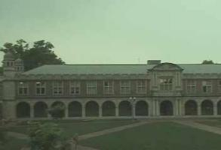
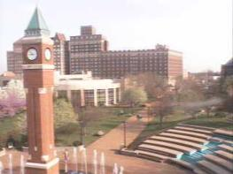
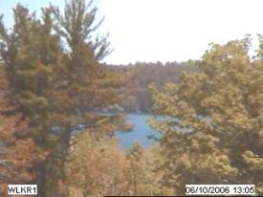
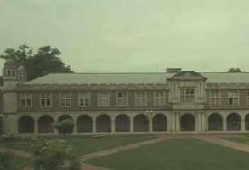
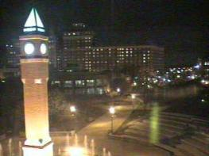
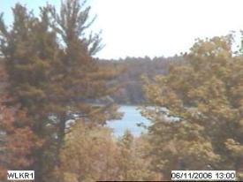
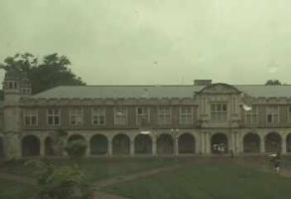
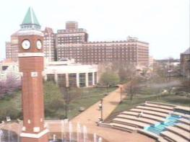
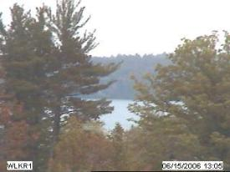
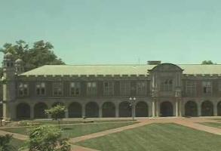
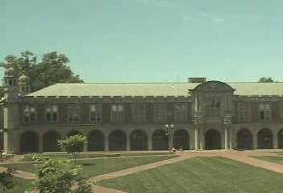
scene tensor factorization
[
]
[
]
[
]
≈
[
]
[
]
[
]
[
]
Dawn
Dusk
Dawn
Dusk

Slide 5
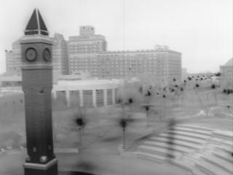
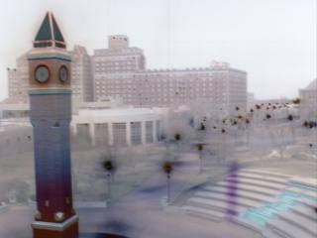
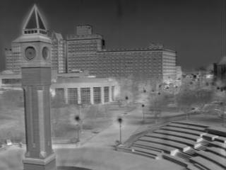
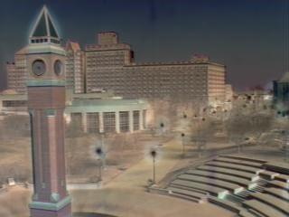
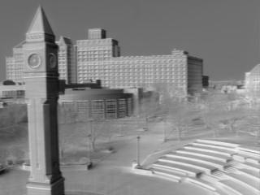
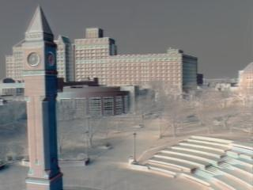
consistent labeling using tensor factorization
R
G
B
Dawn
Dusk

Slide 6
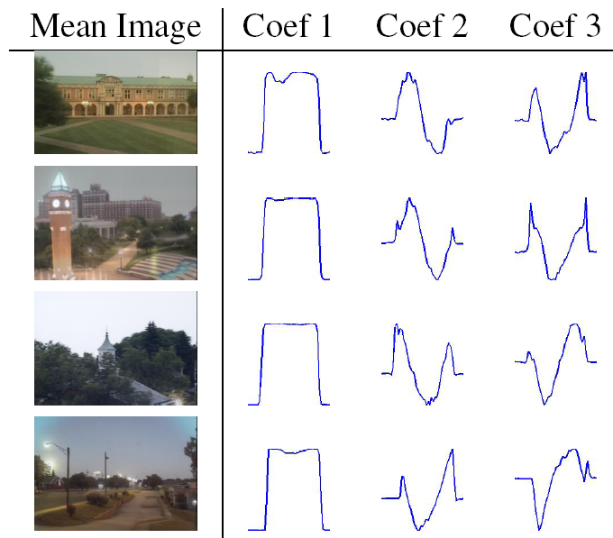
Camera 1
Camera 2
Camera 3
Camera 4
1 day
Jacobs, Roman, Pless. Consistent temporal variations in many outdoor scenes. CVPR 2007

Slide 7
examples of consistent labeling

Slide 8
Why does this work?

Slide 9
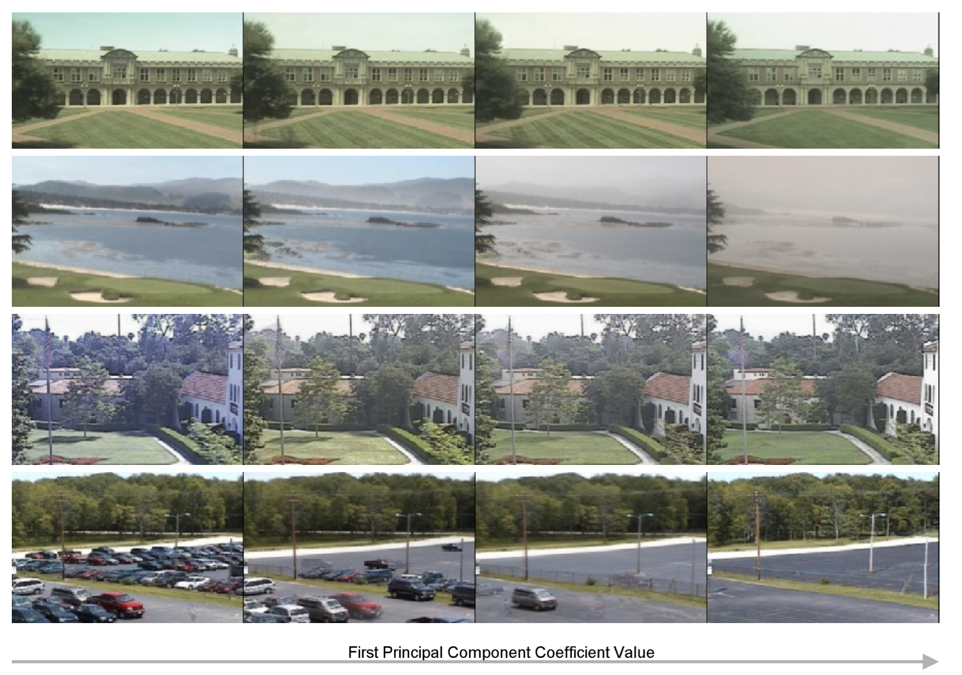
What happens if we choose images just at noon?

Slide 10
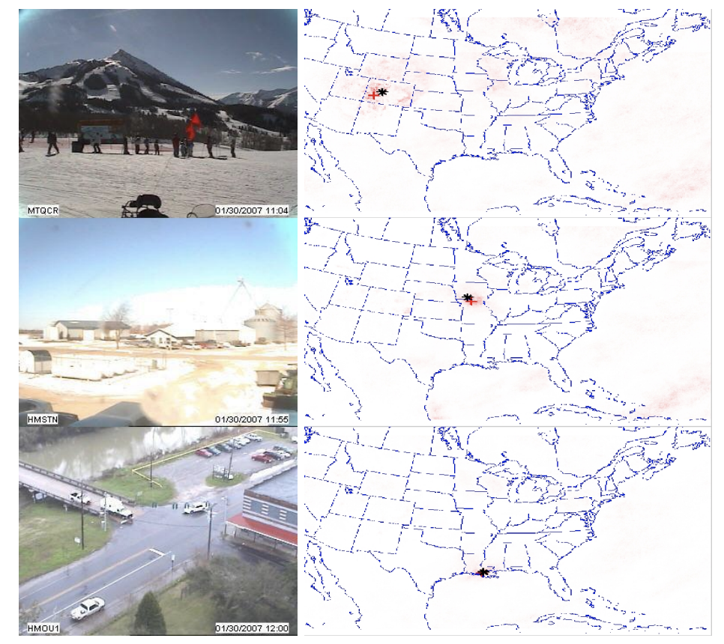
Webcam geolocation:

Slide 11



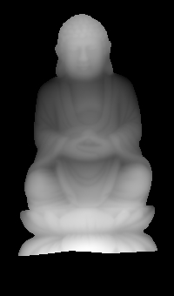

More standard approach: Photometric stereo

Slide 12
Light sources

Slide 13

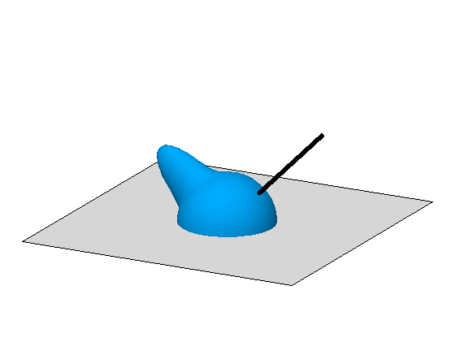

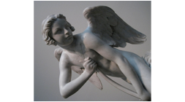
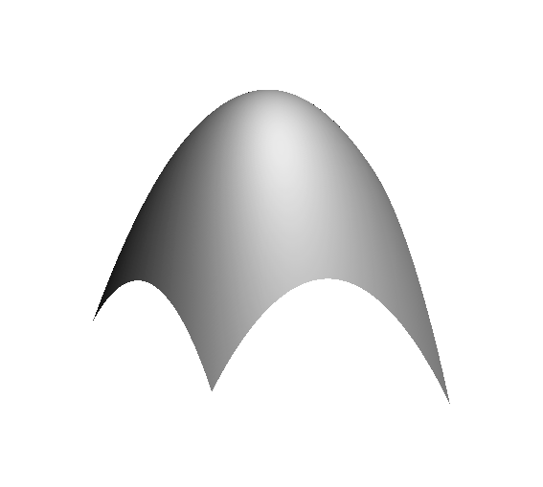
“Physics-based” computer vision
(a.k.a “inverse optics”)
illumination
reflectance
shape
shape
, illumination
, reflectance
Notes:
Our work addresses the problem of inferring scene properties from image data.
Specifically, we want to relate observed image intensities to object shape, scene illumination, and material properties, or surface reflectance.
The task is made difficult by the fact that shape, lighting, and reflectance information are all tightly coupled in the image data so that we cannot typically draw conclusions about one of them without making restrictive assumptions about the others.

Slide 14

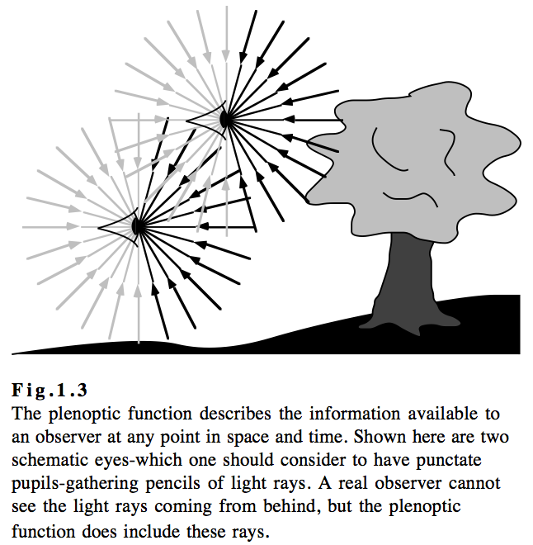
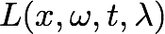
Lighting models: Plenoptic function
Radiance as a function of position and direction
Radiance as a function of position, direction, and time
Spectral radiance as a function of position, direction, time and wavelength
[Adelson and Bergen, 1991]

Slide 15
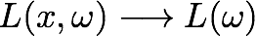
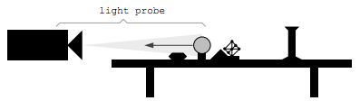
Lighting models: far-field (or directional) approximation
Assume that, over the observed region of interest, all source of incoming flux are relatively far away
radiance only depends on direction; not location
ignores close
inter-reflections
[Debevec, 1998]

Slide 16
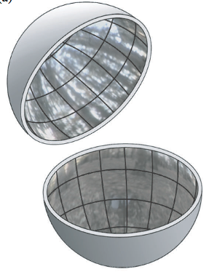
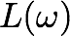

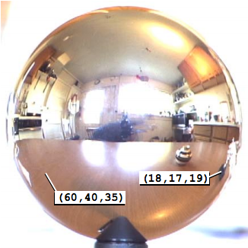
Application: augmented reality
[Debevec, 1998]

Slide 17
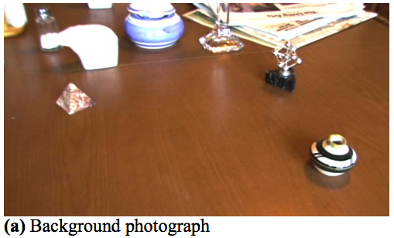
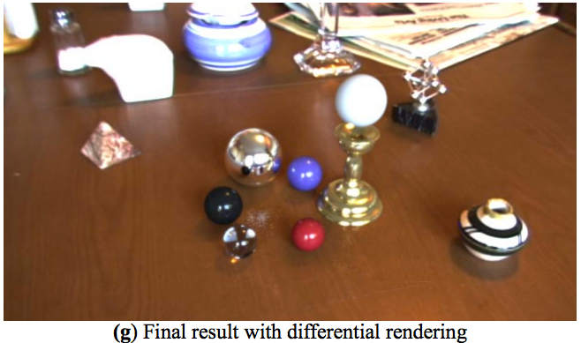
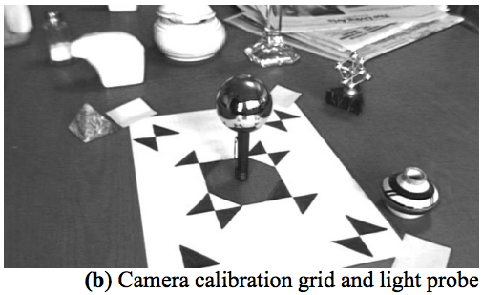
Application: augmented reality
[Debevec, 1998]

Slide 18
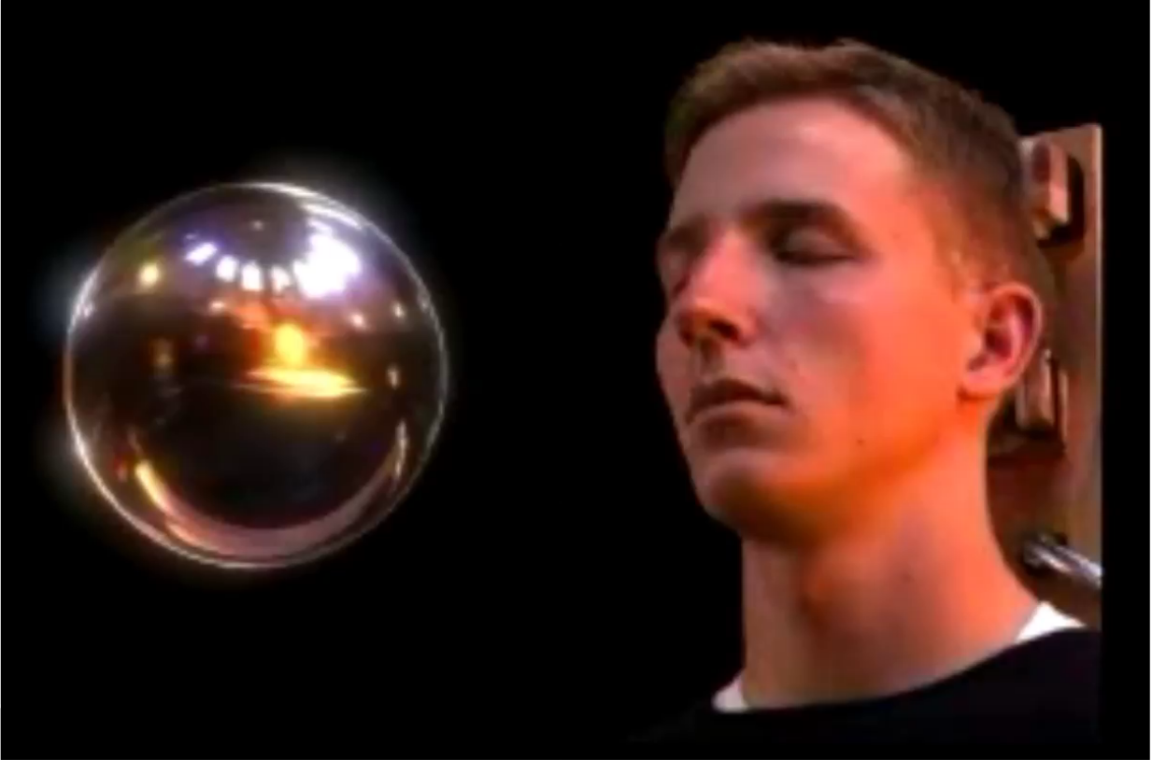
Application: augmented reality
http://gl.ict.usc.edu/LightStages/

Slide 19

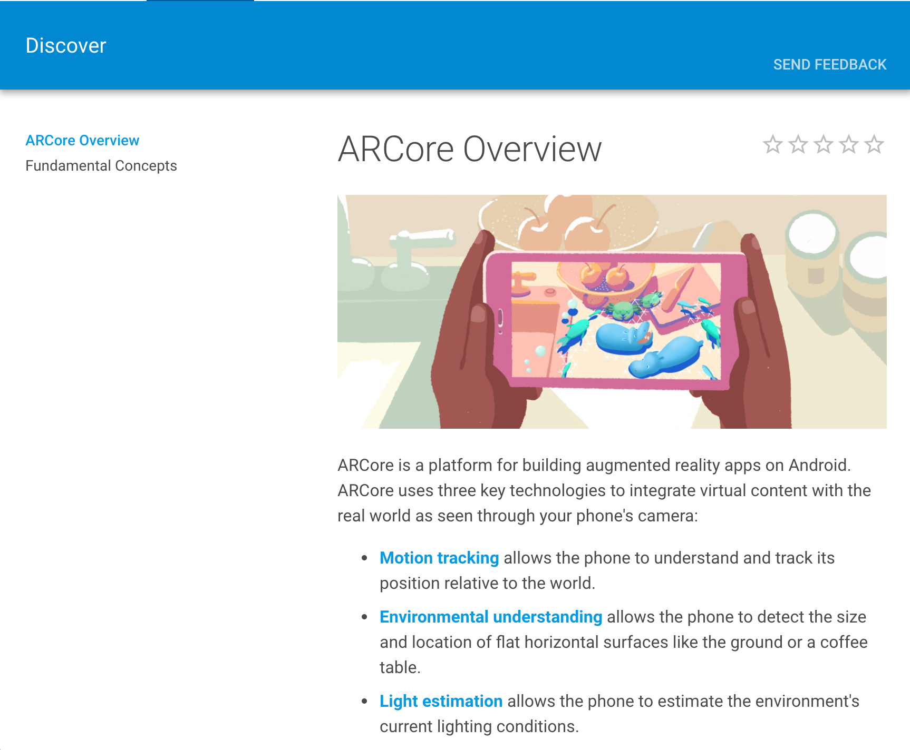
Application: augmented reality
[https://developer.apple.com/arkit/]
[https://developers.google.com/ar/]

Slide 20
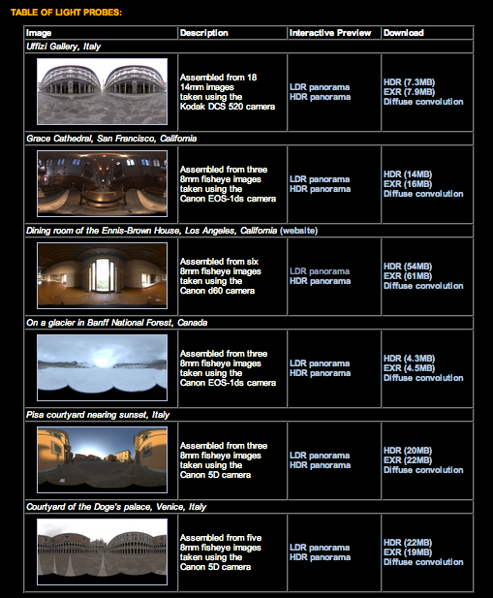
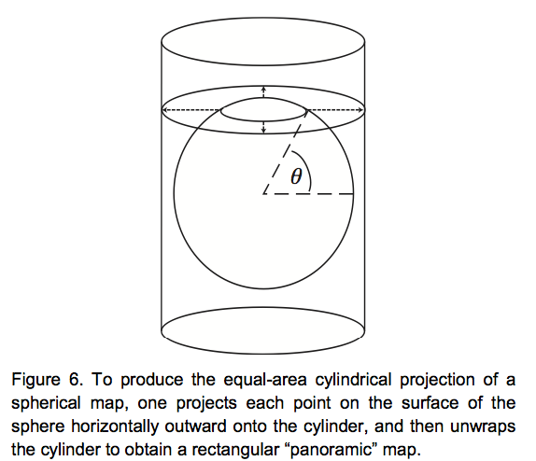
Lighting models: far-field approximation
One can download far-field lighting environments that have been captured by others
A number of apps and software exist to help you capture capture your own environments using a light probe
[http://gl.ict.usc.edu/Data/HighResProbes/]

Slide 21
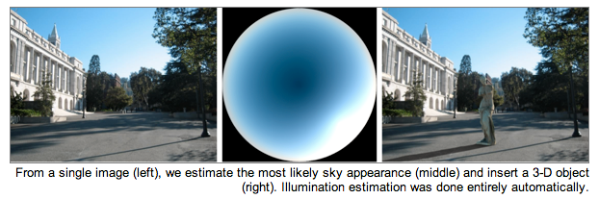
Application: inferring outdoor illumination
[Lalonde et al., 2009]

Slide 22
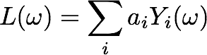
A further simplification:
Low-frequency illumination
First nine basis functions are sufficient for re-creating Lambertian appearance
[Ramamoorthi and Hanrahan, 2001; Basri and Jacobs, 2003]

Slide 23
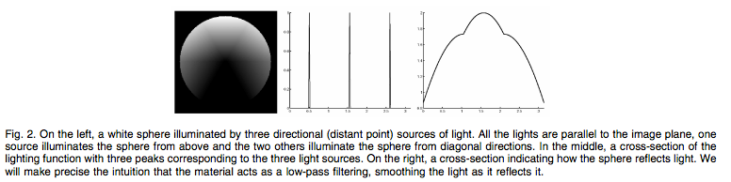

Low-frequency illumination
[Ramamoorthi and Hanrahan, 2001; Basri and Jacobs, 2003]

Slide 24

Low-frequency illumination
Truncate to first 9 terms
[Ramamoorthi and Hanrahan, 2001; Basri and Jacobs, 2003]

Slide 25




Application: Trivial rendering
Capture light probe
Rendering a (convex) diffuse object in this environment simply requires a lookup based on the surface normal at each pixel
Low-pass filter (truncate to first nine SHs)

Slide 26



White-out: Snow and Overcast Skies
CAN’T perceive the shape of the snow covered terrain!
CAN perceive shape in regions
lit by the street lamp!!
WHY?

Slide 27
Diffuse Reflection from Uniform Sky
Assume Lambertian Surface with Albedo = 1 (no absorption)
Assume Sky radiance is constant
Substituting in above Equation:
Radiance of any patch is the same as Sky radiance !! (white-out condition)

Slide 28




Directional lighting
Assume that, over the observed region of interest, all source of incoming flux is from one direction
Convenient representation
“light direction”
“light strength”
Notes:
& L(x,\omega,t,\lambda)\longrightarrow L(x,t,\lambda)\longrightarrow s(t,\lambda)\delta(\omega=\omega_o(t))\\
& L(x,\omega)\longrightarrow L(\omega)\longrightarrow s\delta(\omega=\omega_o)
\vec{\boldsymbol{\ell}}=(\ell_x,\ell_y,\ell_z)
\hat{\boldsymbol{\ell}}=\frac{\vec{\boldsymbol{\ell}}}{||\vec{\boldsymbol{\ell}}||}

Slide 29



Simple shading
ASSUMPTION 1:
LAMBERTIAN
ASSUMPTION 2:
DIRECTIONAL LIGHTING
Notes:
I=a\hat{\bf n}^\top\vec{\boldsymbol{\ell}}

Slide 30
“N-dot-l” shading
ASSUMPTION 1:
LAMBERTIAN
ASSUMPTION 2:
DIRECTIONAL LIGHTING
Notes:
I=a\hat{\bf n}^\top\vec{\boldsymbol{\ell}}

Slide 31
Summary of some useful lighting models
plenoptic function (function on 5D domain)
far-field illumination (function on 2D domain)
low-frequency far-field illumination (nine numbers)
directional lighting (three numbers = direction and strength)
point source (four numbers = location and strength)

Slide 32
Shape from a Single Image?
Given a single image of an object with known surface reflectance taken under a known light source, can we recover the shape of the object?

Slide 33
Human Perception

Slide 34


Examples of the classic bump/dent stimuli used to test lighting assumptions when judging shape from shading, with shading orientations (a) 0° and (b) 180° from the vertical.
Thomas R et al. J Vis 2010;10:6
Notes:
Examples of the classic bump/dent stimuli used to test lighting assumptions when judging shape from shading, with shading orientations (a) 0° and (b) 180° from the vertical.

Slide 35
Human Perception
Our brain often perceives shape from shading.
Mostly, it makes many assumptions to do so.
For example:
Light is coming from above (sun).
Biased by occluding contours.
by V. Ramachandran

Slide 36
Single-lighting is ambiguous
ASSUMPTION 1:
LAMBERTIAN
ASSUMPTION 2:
DIRECTIONAL LIGHTING
Notes:
I=a\hat{\bf n}^\top\vec{\boldsymbol{\ell}}

Slide 37




Lambertian photometric stereo
Assumption: We know the lighting directions.
Notes:
%%% latexit
I_1=a\hat{\boldsymbol{n}}^\top\vec{\boldsymbol{\ell}}_1
\vec{\boldsymbol{b}}\triangleq a\hat{\boldsymbol{n}}
\left[\begin{array}{c}
I_1 \\ I_2 \\ \vdots \\ I_N
\end{array}\right]_{N\times 1}\!\!\!\!\!
=\left[\begin{array}{c}
\vec{\boldsymbol{\ell}}_1^\top \\
\vec{\boldsymbol{\ell}}_2^\top \\
\vdots \\
\vec{\boldsymbol{\ell}}_N^\top \\
\end{array}\right]_{N\times 3}\!\!\!\!\!\!\!\!\!
\left[\begin{array}{c}
\vec{\boldsymbol{b}}
\end{array}\right]_{3\times 1}

Slide 38


Lambertian photometric stereo
define “pseudo-normal”
solve linear system
for pseudo-normal
What are the dimensions of these matrices?
Notes:
%%% latexit
I_1=a\hat{\boldsymbol{n}}^\top\vec{\boldsymbol{\ell}}_1
\vec{\boldsymbol{b}}\triangleq a\hat{\boldsymbol{n}}
\left[\begin{array}{c}
I_1 \\ I_2 \\ \vdots \\ I_N
\end{array}\right]_{N\times 1}\!\!\!\!\!
=\left[\begin{array}{c}
\vec{\boldsymbol{\ell}}_1^\top \\
\vec{\boldsymbol{\ell}}_2^\top \\
\vdots \\
\vec{\boldsymbol{\ell}}_N^\top \\
\end{array}\right]_{N\times 3}\!\!\!\!\!\!\!\!\!
\left[\begin{array}{c}
\vec{\boldsymbol{b}}
\end{array}\right]_{3\times 1}

Slide 39
Lambertian photometric stereo
define “pseudo-normal”
solve linear system
for pseudo-normal
What are the knowns and unknowns?
Notes:
%%% latexit
I_1=a\hat{\boldsymbol{n}}^\top\vec{\boldsymbol{\ell}}_1
\vec{\boldsymbol{b}}\triangleq a\hat{\boldsymbol{n}}
\left[\begin{array}{c}
I_1 \\ I_2 \\ \vdots \\ I_N
\end{array}\right]_{N\times 1}\!\!\!\!\!
=\left[\begin{array}{c}
\vec{\boldsymbol{\ell}}_1^\top \\
\vec{\boldsymbol{\ell}}_2^\top \\
\vdots \\
\vec{\boldsymbol{\ell}}_N^\top \\
\end{array}\right]_{N\times 3}\!\!\!\!\!\!\!\!\!
\left[\begin{array}{c}
\vec{\boldsymbol{b}}
\end{array}\right]_{3\times 1}

Slide 40
Lambertian photometric stereo
define “pseudo-normal”
solve linear system
for pseudo-normal
How many lights do I need for unique solution?
Notes:
%%% latexit
I_1=a\hat{\boldsymbol{n}}^\top\vec{\boldsymbol{\ell}}_1
\vec{\boldsymbol{b}}\triangleq a\hat{\boldsymbol{n}}
\left[\begin{array}{c}
I_1 \\ I_2 \\ \vdots \\ I_N
\end{array}\right]_{N\times 1}\!\!\!\!\!
=\left[\begin{array}{c}
\vec{\boldsymbol{\ell}}_1^\top \\
\vec{\boldsymbol{\ell}}_2^\top \\
\vdots \\
\vec{\boldsymbol{\ell}}_N^\top \\
\end{array}\right]_{N\times 3}\!\!\!\!\!\!\!\!\!
\left[\begin{array}{c}
\vec{\boldsymbol{b}}
\end{array}\right]_{3\times 1}

Slide 41
Lambertian photometric stereo
define “pseudo-normal”
solve linear system
for pseudo-normal
once system is solved, b gives normal direction and albedo
How do we solve this system?
Notes:
%%% latexit
I_1=a\hat{\boldsymbol{n}}^\top\vec{\boldsymbol{\ell}}_1
\vec{\boldsymbol{b}}\triangleq a\hat{\boldsymbol{n}}
\left[\begin{array}{c}
I_1 \\ I_2 \\ \vdots \\ I_N
\end{array}\right]_{N\times 1}\!\!\!\!\!
=\left[\begin{array}{c}
\vec{\boldsymbol{\ell}}_1^\top \\
\vec{\boldsymbol{\ell}}_2^\top \\
\vdots \\
\vec{\boldsymbol{\ell}}_N^\top \\
\end{array}\right]_{N\times 3}\!\!\!\!\!\!\!\!\!
\left[\begin{array}{c}
\vec{\boldsymbol{b}}
\end{array}\right]_{3\times 1}

Slide 42
Solving the Equation with three lights
inverse
Is there any reason to use more than three lights?

Slide 43
More than Three Light Sources
Get better SNR by using more lights
Least squares solution:
Moore-Penrose pseudo inverse
Solve for as before

Slide 44

Computing light source directions
Trick: place a chrome sphere in the scene
the location of the highlight tells you the source direction

Slide 45
Limitations
Big problems
Doesn’t work for shiny things, semi-translucent things
Shadows, inter-reflections
Smaller problems
Camera and lights have to be distant
Calibration requirements
measure light source directions, intensities
camera response function

Slide 46

Depth from normals
Solving the linear system per-pixel gives us an estimated surface normal for each pixel
How can we compute depth from normals?
Normals are like the “derivative” of the true depth
Input photo
Estimated normals
Estimated normals (needle diagram)

Slide 47

Normal Integration
Integrating a set of derivatives is easy in 1D
(similar to Euler’s method from diff. eq. class)
Could just integrate normals in each column / row separately
Instead, we formulate as a linear system and solve for depths that best agree with the surface normals

Slide 48
Results
Estimate light source directions
Compute surface normals
Compute albedo values
Estimate depth from surface normals
Relight the object (with original texture and uniform albedo)

Slide 49


Results: Lambertian Sphere
Input Images
Needles are projections
of surface normals on
image plane
Estimated Surface Normals
Estimated Albedo

Slide 50



Lambertain Mask

Slide 51


Results – Albedo and Surface Normal

Slide 52

Results – Shape of Mask

Slide 53






Results: Lambertian Toy
I.2
Input Images
Estimated Surface Normals
Estimated Albedo

Slide 54



Non-idealities: interreflections

Slide 55


Non-idealities: interreflections
Shallow reconstruction
(effect of interreflections)
Accurate reconstruction
(after removing interreflections)

Slide 56
What if the light directions are unknown?
Notes:
%%% latexit
I_1=a\hat{\boldsymbol{n}}^\top\vec{\boldsymbol{\ell}}_1
\vec{\boldsymbol{b}}\triangleq a\hat{\boldsymbol{n}}
\left[\begin{array}{c}
I_1 \\ I_2 \\ \vdots \\ I_N
\end{array}\right]_{N\times 1}\!\!\!\!\!
=\left[\begin{array}{c}
\vec{\boldsymbol{\ell}}_1^\top \\
\vec{\boldsymbol{\ell}}_2^\top \\
\vdots \\
\vec{\boldsymbol{\ell}}_N^\top \\
\end{array}\right]_{N\times 3}\!\!\!\!\!\!\!\!\!
\left[\begin{array}{c}
\vec{\boldsymbol{b}}
\end{array}\right]_{3\times 1}

Slide 57
Uncalibrated photometric stereo

Slide 58
What if the light directions are unknown?
define “pseudo-normal”
solve linear system
for pseudo-normal
Notes:
%%% latexit
I_1=a\hat{\boldsymbol{n}}^\top\vec{\boldsymbol{\ell}}_1
\vec{\boldsymbol{b}}\triangleq a\hat{\boldsymbol{n}}
\left[\begin{array}{c}
I_1 \\ I_2 \\ \vdots \\ I_N
\end{array}\right]_{N\times 1}\!\!\!\!\!
=\left[\begin{array}{c}
\vec{\boldsymbol{\ell}}_1^\top \\
\vec{\boldsymbol{\ell}}_2^\top \\
\vdots \\
\vec{\boldsymbol{\ell}}_N^\top \\
\end{array}\right]_{N\times 3}\!\!\!\!\!\!\!\!\!
\left[\begin{array}{c}
\vec{\boldsymbol{b}}
\end{array}\right]_{3\times 1}

Slide 59



What if the light directions are unknown?
define “pseudo-normal”
solve linear system
for pseudo-normal at each image pixel
$$B$$
$$M$$
M: number of pixels
$$M$$
Notes:
%%% latexit
I_1=a\hat{\boldsymbol{n}}^\top\vec{\boldsymbol{\ell}}_1
\vec{\boldsymbol{b}}\triangleq a\hat{\boldsymbol{n}}
\left[\begin{array}{c}
I_1 \\ I_2 \\ \vdots \\ I_N
\end{array}\right]_{N\times 1}\!\!\!\!\!
=\left[\begin{array}{c}
\vec{\boldsymbol{\ell}}_1^\top \\
\vec{\boldsymbol{\ell}}_2^\top \\
\vdots \\
\vec{\boldsymbol{\ell}}_N^\top \\
\end{array}\right]_{N\times 3}\!\!\!\!\!\!\!\!\!
\left[\begin{array}{c}
\vec{\boldsymbol{b}}
\end{array}\right]_{3\times 1}

Slide 60
What if the light directions are unknown?
define “pseudo-normal”
solve linear system
for pseudo-normal at each image pixel
How do we solve this system without knowing light matrix L?
$$B$$
$$M$$
$$M$$
Notes:
%%% latexit
I_1=a\hat{\boldsymbol{n}}^\top\vec{\boldsymbol{\ell}}_1
\vec{\boldsymbol{b}}\triangleq a\hat{\boldsymbol{n}}
\left[\begin{array}{c}
I_1 \\ I_2 \\ \vdots \\ I_N
\end{array}\right]_{N\times 1}\!\!\!\!\!
=\left[\begin{array}{c}
\vec{\boldsymbol{\ell}}_1^\top \\
\vec{\boldsymbol{\ell}}_2^\top \\
\vdots \\
\vec{\boldsymbol{\ell}}_N^\top \\
\end{array}\right]_{N\times 3}\!\!\!\!\!\!\!\!\!
\left[\begin{array}{c}
\vec{\boldsymbol{b}}
\end{array}\right]_{3\times 1}

Slide 61

Factorizing the measurement matrix
Lights
Pseudonormals
What are the dimensions?

Slide 62

Factorizing the measurement matrix
Singular value decomposition:
This decomposition minimizes |I-LB|²

Slide 63
Are the results unique?
Notes:
%%% latexit
I_1=a\hat{\boldsymbol{n}}^\top\vec{\boldsymbol{\ell}}_1
\vec{\boldsymbol{b}}\triangleq a\hat{\boldsymbol{n}}
\left[\begin{array}{c}
I_1 \\ I_2 \\ \vdots \\ I_N
\end{array}\right]_{N\times 1}\!\!\!\!\!
=\left[\begin{array}{c}
\vec{\boldsymbol{\ell}}_1^\top \\
\vec{\boldsymbol{\ell}}_2^\top \\
\vdots \\
\vec{\boldsymbol{\ell}}_N^\top \\
\end{array}\right]_{N\times 3}\!\!\!\!\!\!\!\!\!
\left[\begin{array}{c}
\vec{\boldsymbol{b}}
\end{array}\right]_{3\times 1}

Slide 64
Are the results unique?
We can insert any 3x3 matrix Q in the decomposition and get the same images:
I = L B = (L Q⁻¹) (Q B)
Notes:
%%% latexit
I_1=a\hat{\boldsymbol{n}}^\top\vec{\boldsymbol{\ell}}_1
\vec{\boldsymbol{b}}\triangleq a\hat{\boldsymbol{n}}
\left[\begin{array}{c}
I_1 \\ I_2 \\ \vdots \\ I_N
\end{array}\right]_{N\times 1}\!\!\!\!\!
=\left[\begin{array}{c}
\vec{\boldsymbol{\ell}}_1^\top \\
\vec{\boldsymbol{\ell}}_2^\top \\
\vdots \\
\vec{\boldsymbol{\ell}}_N^\top \\
\end{array}\right]_{N\times 3}\!\!\!\!\!\!\!\!\!
\left[\begin{array}{c}
\vec{\boldsymbol{b}}
\end{array}\right]_{3\times 1}

Slide 65
Are the results unique?
We can insert any 3x3 matrix Q in the decomposition and get the same images:
I = L B = (L Q⁻¹) (Q B)
Can we use any assumptions to remove some of these 9 degrees of freedom?
Notes:
%%% latexit
I_1=a\hat{\boldsymbol{n}}^\top\vec{\boldsymbol{\ell}}_1
\vec{\boldsymbol{b}}\triangleq a\hat{\boldsymbol{n}}
\left[\begin{array}{c}
I_1 \\ I_2 \\ \vdots \\ I_N
\end{array}\right]_{N\times 1}\!\!\!\!\!
=\left[\begin{array}{c}
\vec{\boldsymbol{\ell}}_1^\top \\
\vec{\boldsymbol{\ell}}_2^\top \\
\vdots \\
\vec{\boldsymbol{\ell}}_N^\top \\
\end{array}\right]_{N\times 3}\!\!\!\!\!\!\!\!\!
\left[\begin{array}{c}
\vec{\boldsymbol{b}}
\end{array}\right]_{3\times 1}

Slide 66
Generalized bas-relief ambiguity

Slide 67
Enforcing integrability
What does the matrix B correspond to?
Notes:
%%% latexit
I_1=a\hat{\boldsymbol{n}}^\top\vec{\boldsymbol{\ell}}_1
\vec{\boldsymbol{b}}\triangleq a\hat{\boldsymbol{n}}
\left[\begin{array}{c}
I_1 \\ I_2 \\ \vdots \\ I_N
\end{array}\right]_{N\times 1}\!\!\!\!\!
=\left[\begin{array}{c}
\vec{\boldsymbol{\ell}}_1^\top \\
\vec{\boldsymbol{\ell}}_2^\top \\
\vdots \\
\vec{\boldsymbol{\ell}}_N^\top \\
\end{array}\right]_{N\times 3}\!\!\!\!\!\!\!\!\!
\left[\begin{array}{c}
\vec{\boldsymbol{b}}
\end{array}\right]_{3\times 1}

Slide 68




Enforcing integrability
What does the matrix B correspond to?
Surface representation as a depth image (also known as Monge surface):
$$z=f(x,y)$$
depth at each pixel
pixel coordinates in image space
Unnormalized normal:
$$\tilde{n}\left(x,y\right)=\left(\frac{df}{dx},\frac{df}{dy},−1\right)$$
Actual normal:
$$n(x,y)=\tilde{n}\left(x,y\right)/\left\|\tilde{n}\left(x,y\right)\right\|$$
Pseudo-normal:
$$b(x,y)=a\left(x,y\right)n\left(x,y\right)$$
Rearrange into 3xN matrix B.
Notes:
%%% latexit
I_1=a\hat{\boldsymbol{n}}^\top\vec{\boldsymbol{\ell}}_1
\vec{\boldsymbol{b}}\triangleq a\hat{\boldsymbol{n}}
\left[\begin{array}{c}
I_1 \\ I_2 \\ \vdots \\ I_N
\end{array}\right]_{N\times 1}\!\!\!\!\!
=\left[\begin{array}{c}
\vec{\boldsymbol{\ell}}_1^\top \\
\vec{\boldsymbol{\ell}}_2^\top \\
\vdots \\
\vec{\boldsymbol{\ell}}_N^\top \\
\end{array}\right]_{N\times 3}\!\!\!\!\!\!\!\!\!
\left[\begin{array}{c}
\vec{\boldsymbol{b}}
\end{array}\right]_{3\times 1}

Slide 69
Enforcing integrability
What does the integrability constraint correspond to?
Notes:
%%% latexit
I_1=a\hat{\boldsymbol{n}}^\top\vec{\boldsymbol{\ell}}_1
\vec{\boldsymbol{b}}\triangleq a\hat{\boldsymbol{n}}
\left[\begin{array}{c}
I_1 \\ I_2 \\ \vdots \\ I_N
\end{array}\right]_{N\times 1}\!\!\!\!\!
=\left[\begin{array}{c}
\vec{\boldsymbol{\ell}}_1^\top \\
\vec{\boldsymbol{\ell}}_2^\top \\
\vdots \\
\vec{\boldsymbol{\ell}}_N^\top \\
\end{array}\right]_{N\times 3}\!\!\!\!\!\!\!\!\!
\left[\begin{array}{c}
\vec{\boldsymbol{b}}
\end{array}\right]_{3\times 1}

Slide 70

Enforcing integrability
What does the integrability constraint correspond to?
Differentiation order should not matter:
$$\frac{d}{dy}\frac{df(x,y)}{dx}=\frac{d}{dx}\frac{df(x,y)}{dy}$$
Can you think of a way to express the above using pseudo-normals b?
Notes:
%%% latexit
I_1=a\hat{\boldsymbol{n}}^\top\vec{\boldsymbol{\ell}}_1
\vec{\boldsymbol{b}}\triangleq a\hat{\boldsymbol{n}}
\left[\begin{array}{c}
I_1 \\ I_2 \\ \vdots \\ I_N
\end{array}\right]_{N\times 1}\!\!\!\!\!
=\left[\begin{array}{c}
\vec{\boldsymbol{\ell}}_1^\top \\
\vec{\boldsymbol{\ell}}_2^\top \\
\vdots \\
\vec{\boldsymbol{\ell}}_N^\top \\
\end{array}\right]_{N\times 3}\!\!\!\!\!\!\!\!\!
\left[\begin{array}{c}
\vec{\boldsymbol{b}}
\end{array}\right]_{3\times 1}

Slide 71

Enforcing integrability
What does the integrability constraint correspond to?
Differentiation order should not matter:
$$\frac{d}{dy}\frac{df(x,y)}{dx}=\frac{d}{dx}\frac{df(x,y)}{dy}$$
Can you think of a way to express the above using pseudo-normals b?
$$\frac{d}{dy}\frac{b_{1}(x,y)}{b_{3}(x,y)}=\frac{d}{dx}\frac{b_{2}(x,y)}{b_{3}(x,y)}$$
Notes:
%%% latexit
I_1=a\hat{\boldsymbol{n}}^\top\vec{\boldsymbol{\ell}}_1
\vec{\boldsymbol{b}}\triangleq a\hat{\boldsymbol{n}}
\left[\begin{array}{c}
I_1 \\ I_2 \\ \vdots \\ I_N
\end{array}\right]_{N\times 1}\!\!\!\!\!
=\left[\begin{array}{c}
\vec{\boldsymbol{\ell}}_1^\top \\
\vec{\boldsymbol{\ell}}_2^\top \\
\vdots \\
\vec{\boldsymbol{\ell}}_N^\top \\
\end{array}\right]_{N\times 3}\!\!\!\!\!\!\!\!\!
\left[\begin{array}{c}
\vec{\boldsymbol{b}}
\end{array}\right]_{3\times 1}

Slide 72
Enforcing integrability
What does the integrability constraint correspond to?
Differentiation order should not matter:
$$\frac{d}{dy}\frac{df(x,y)}{dx}=\frac{d}{dx}\frac{df(x,y)}{dy}$$
Can you think of a way to express the above using pseudo-normals b?
$$\frac{d}{dy}\frac{b_{1}(x,y)}{b_{3}(x,y)}=\frac{d}{dx}\frac{b_{2}(x,y)}{b_{3}(x,y)}$$
Simplify to:
$$b_{3}\left(x,y\right)\frac{db_{1}\left(x,y\right)}{dy}−b_{1}(x,y)\frac{db_{3}(x,y)}{dy}=b_{2}\left(x,y\right)\frac{db_{1}\left(x,y\right)}{dx}−b_{1}(x,y)\frac{db_{2}(x,y)}{dx}$$
Notes:
%%% latexit
I_1=a\hat{\boldsymbol{n}}^\top\vec{\boldsymbol{\ell}}_1
\vec{\boldsymbol{b}}\triangleq a\hat{\boldsymbol{n}}
\left[\begin{array}{c}
I_1 \\ I_2 \\ \vdots \\ I_N
\end{array}\right]_{N\times 1}\!\!\!\!\!
=\left[\begin{array}{c}
\vec{\boldsymbol{\ell}}_1^\top \\
\vec{\boldsymbol{\ell}}_2^\top \\
\vdots \\
\vec{\boldsymbol{\ell}}_N^\top \\
\end{array}\right]_{N\times 3}\!\!\!\!\!\!\!\!\!
\left[\begin{array}{c}
\vec{\boldsymbol{b}}
\end{array}\right]_{3\times 1}

Slide 73
Enforcing integrability
What does the integrability constraint correspond to?
Differentiation order should not matter:
$$\frac{d}{dy}\frac{df(x,y)}{dx}=\frac{d}{dx}\frac{df(x,y)}{dy}$$
Can you think of a way to express the above using pseudo-normals b?
$$\frac{d}{dy}\frac{b_{1}(x,y)}{b_{3}(x,y)}=\frac{d}{dx}\frac{b_{2}(x,y)}{b_{3}(x,y)}$$
Simplify to:
$$b_{3}\left(x,y\right)\frac{db_{1}\left(x,y\right)}{dy}−b_{1}(x,y)\frac{db_{3}(x,y)}{dy}=b_{2}\left(x,y\right)\frac{db_{1}\left(x,y\right)}{dx}−b_{1}(x,y)\frac{db_{2}(x,y)}{dx}$$
If B_{e} is the pseudo-normal matrix we get from SVD, then find the 3x3 transform D such that B=D⋅B_{e} is the closest to satisfying integrability in the least-squares sense.
Notes:
%%% latexit
I_1=a\hat{\boldsymbol{n}}^\top\vec{\boldsymbol{\ell}}_1
\vec{\boldsymbol{b}}\triangleq a\hat{\boldsymbol{n}}
\left[\begin{array}{c}
I_1 \\ I_2 \\ \vdots \\ I_N
\end{array}\right]_{N\times 1}\!\!\!\!\!
=\left[\begin{array}{c}
\vec{\boldsymbol{\ell}}_1^\top \\
\vec{\boldsymbol{\ell}}_2^\top \\
\vdots \\
\vec{\boldsymbol{\ell}}_N^\top \\
\end{array}\right]_{N\times 3}\!\!\!\!\!\!\!\!\!
\left[\begin{array}{c}
\vec{\boldsymbol{b}}
\end{array}\right]_{3\times 1}

Slide 74
Enforcing integrability
Does enforcing integrability remove all ambiguities?
Notes:
%%% latexit
I_1=a\hat{\boldsymbol{n}}^\top\vec{\boldsymbol{\ell}}_1
\vec{\boldsymbol{b}}\triangleq a\hat{\boldsymbol{n}}
\left[\begin{array}{c}
I_1 \\ I_2 \\ \vdots \\ I_N
\end{array}\right]_{N\times 1}\!\!\!\!\!
=\left[\begin{array}{c}
\vec{\boldsymbol{\ell}}_1^\top \\
\vec{\boldsymbol{\ell}}_2^\top \\
\vdots \\
\vec{\boldsymbol{\ell}}_N^\top \\
\end{array}\right]_{N\times 3}\!\!\!\!\!\!\!\!\!
\left[\begin{array}{c}
\vec{\boldsymbol{b}}
\end{array}\right]_{3\times 1}

Slide 75


Generalized Bas-relief ambiguity
If B is integrable, then:
B’=G^{-T}⋅B is also integrable for all G of the form ($λ$ ≠ 0)
$$G=\left[\begin{matrix}1 & 0 & 0 \\ 0 & 1 & 0 \\ μ & ν & λ\end{matrix}\right]$$
Combined with transformed lights S’=G⋅S, the transformed pseudonormals produce the same images as the original pseudonormals.
This ambiguity cannot be removed using shadows.
This ambiguity can be removed using interreflections or additional assumptions.
This ambiguity is known as the generalized bas-relief ambiguity.
Notes:
%%% latexit
I_1=a\hat{\boldsymbol{n}}^\top\vec{\boldsymbol{\ell}}_1
\vec{\boldsymbol{b}}\triangleq a\hat{\boldsymbol{n}}
\left[\begin{array}{c}
I_1 \\ I_2 \\ \vdots \\ I_N
\end{array}\right]_{N\times 1}\!\!\!\!\!
=\left[\begin{array}{c}
\vec{\boldsymbol{\ell}}_1^\top \\
\vec{\boldsymbol{\ell}}_2^\top \\
\vdots \\
\vec{\boldsymbol{\ell}}_N^\top \\
\end{array}\right]_{N\times 3}\!\!\!\!\!\!\!\!\!
\left[\begin{array}{c}
\vec{\boldsymbol{b}}
\end{array}\right]_{3\times 1}

Slide 76


Generalized Bas-relief ambiguity
When $μ$ = $ν$ = 0, G is equivalent to the transformation employed by relief sculptures.
Otherwise, includes shearing.
When $μ$ = $ν$ = 0 and $λ$ = +-1, top/down ambiguity.
Notes:
%%% latexit
I_1=a\hat{\boldsymbol{n}}^\top\vec{\boldsymbol{\ell}}_1
\vec{\boldsymbol{b}}\triangleq a\hat{\boldsymbol{n}}
\left[\begin{array}{c}
I_1 \\ I_2 \\ \vdots \\ I_N
\end{array}\right]_{N\times 1}\!\!\!\!\!
=\left[\begin{array}{c}
\vec{\boldsymbol{\ell}}_1^\top \\
\vec{\boldsymbol{\ell}}_2^\top \\
\vdots \\
\vec{\boldsymbol{\ell}}_N^\top \\
\end{array}\right]_{N\times 3}\!\!\!\!\!\!\!\!\!
\left[\begin{array}{c}
\vec{\boldsymbol{b}}
\end{array}\right]_{3\times 1}

Slide 77
What assumptions have we made for all this?
Notes:
%%% latexit
I_1=a\hat{\boldsymbol{n}}^\top\vec{\boldsymbol{\ell}}_1
\vec{\boldsymbol{b}}\triangleq a\hat{\boldsymbol{n}}
\left[\begin{array}{c}
I_1 \\ I_2 \\ \vdots \\ I_N
\end{array}\right]_{N\times 1}\!\!\!\!\!
=\left[\begin{array}{c}
\vec{\boldsymbol{\ell}}_1^\top \\
\vec{\boldsymbol{\ell}}_2^\top \\
\vdots \\
\vec{\boldsymbol{\ell}}_N^\top \\
\end{array}\right]_{N\times 3}\!\!\!\!\!\!\!\!\!
\left[\begin{array}{c}
\vec{\boldsymbol{b}}
\end{array}\right]_{3\times 1}

Slide 78
What assumptions have we made for all this?
Lambertian BRDF
Directional lighting
No interreflections or scattering
Notes:
%%% latexit
I_1=a\hat{\boldsymbol{n}}^\top\vec{\boldsymbol{\ell}}_1
\vec{\boldsymbol{b}}\triangleq a\hat{\boldsymbol{n}}
\left[\begin{array}{c}
I_1 \\ I_2 \\ \vdots \\ I_N
\end{array}\right]_{N\times 1}\!\!\!\!\!
=\left[\begin{array}{c}
\vec{\boldsymbol{\ell}}_1^\top \\
\vec{\boldsymbol{\ell}}_2^\top \\
\vdots \\
\vec{\boldsymbol{\ell}}_N^\top \\
\end{array}\right]_{N\times 3}\!\!\!\!\!\!\!\!\!
\left[\begin{array}{c}
\vec{\boldsymbol{b}}
\end{array}\right]_{3\times 1}

Slide 79








Shape independent of BRDF via reciprocity:
“Helmholtz Stereopsis”
[Zickler et al., 2002]

Slide 80
Shape from shading

Slide 81


Single-lighting is ambiguous
ASSUMPTION 1:
LAMBERTIAN
ASSUMPTION 2:
DIRECTIONAL LIGHTING
[Prados, 2004]
Notes:
I=a\hat{\bf n}^\top\vec{\boldsymbol{\ell}}

Slide 82
Stereographic Projection
(p,q)-space (gradient space)
(f,g)-space
Problem
(p,q) can be infinite when
Redefine reflectance map as

Slide 83
Image Irradiance Constraint
Image irradiance should match the reflectance map
Minimize
(minimize errors in image irradiance in the image)

Slide 84
Smoothness Constraint
Used to constrain shape-from-shading
Relates orientations (f,g) of neighboring surface points
Minimize
: surface orientation under stereographic projection
(penalize rapid changes in surface orientation f and g over the image)

Slide 85
Shape-from-Shading
Find surface orientations (f,g) at all image points that minimize
weight
smoothness
constraint
image irradiance
error
Minimize

Slide 86
Numerical Shape-from-Shading
Smoothness error at image point (i,j)
Of course you can consider more neighbors (smoother results)
Image irradiance error at image point (i,j)
Find and that minimize
(Ikeuchi & Horn 89)

Slide 87
Numerical Shape-from-Shading
Find and that minimize
If and minimize , then
where and are 4-neighbors average around image point (k,l)
(Ikeuchi & Horn 89)

Slide 88
Numerical Shape-from-Shading
Update rule
Use known values on the occluding boundary to constrain the solution (boundary conditions)
Compare with for convergence test
As the solution converges, increase to remove the smoothness constraint
(Ikeuchi & Horn 89)

Slide 89

Results

Slide 90

Results

Slide 91

More modern results

Slide 92
References
Basic reading:
Szeliski, Section 2.2.
Gortler, Chapter 21.
This book by Steven Gortler has a great introduction to radiometry, reflectance, and their use for image formation.
Additional reading:
Oren and Nayar, “Generalization of the Lambertian model and implications for machine vision,” IJCV 1995.
The paper introducing the most common model for rough diffuse reflectance.
Debevec, “Rendering Synthetic Objects into Real Scenes,” SIGGRAPH 1998.
The paper that introduced the notion of the environment map, the use of chrome spheres for measuring such maps, and the idea that they can be used for easy rendering.
Lalonde et al., “Estimating the Natural Illumination Conditions from a Single Outdoor Image,” IJCV 2012.
A paper on estimating outdoors environment maps from just one image.
Basri and Jacobs, “Lambertian reflectance and linear subspaces,” ICCV 2001.
Ramamoorthi and Hanrahan, “A signal-processing framework for inverse rendering,” SIGGRAPH 2001.
Sloan et al., “Precomputed radiance transfer for real-time rendering in dynamic, low-frequency lighting environments,” SIGGRAPH 2002.
Three papers describing the use of spherical harmonics to model low-frequency illumination, as well as the low-pass filtering effect of Lambertian reflectance on illumination.
Zhang et al., “Shape-from-shading: a survey,” PAMI 1999.
A review of perceptual and computational aspects of shape from shading.
Woodham, “Photometric method for determining surface orientation from multiple images,” Optical Engineering 1980.
The paper that introduced photometric stereo.
Yuille and Snow, “Shape and albedo from multiple images using integrability,” CVPR 1997.
Belhumeur et al., “The bas-relief ambiguity,” IJCV 1999.
Papadhimitri and Favaro, “A new perspective on uncalibrated photometric stereo,” CVPR 2013.
Three papers discussing uncalibrated photometric stereo. The first paper shows that, when the lighting directions are not known, by assuming integrability, one can reduce unknowns to the bas-relief ambiguity. The second paper discusses the bas-relief ambiguity in a more general context. The third paper shows that, if instead of an orthographic camera one uses a perspective camera, this is further reduced to just a scale ambiguity.
Alldrin et al., “Resolving the generalized bas-relief ambiguity by entropy minimization,” CVPR 2007.
A popular technique for resolving the bas-relief ambiguity in uncalibrated photometric stereo.
Zickler et al., “Helmholtz stereopsis: Exploiting reciprocity for surface reconstruction,” IJCV 2002.
A method for photometric stereo reconstruction under arbitrary BRDF.
Nayar et al., “Shape from interreflections,” IJCV 1991.
Chandraker et al., “Reflections on the generalized bas-relief ambiguity,” CVPR 2005.
Two papers discussing how one can perform photometric stereo (calibrated or otherwise) in the presence of strong interreflections.
Frankot and Chellappa, “A method for enforcing integrability in shape from shading algorithms,” PAMI 1988.
Agrawal et al., “What is the range of surface reconstructions from a gradient field?,” ECCV 2006.
Two papers discussing how one can integrate a normal field to reconstruct a surface.
Notes:
Ch

